Slide 1
Dissemination Channels for the 2011 Census data Accessing ONS data
Callum Foster
Office for National Statistics

Slide 2
.. or from your perspective
“How and when can I get my hands on the Census data, and what tools will we be provided to help me access and use the data?”

Slide 3
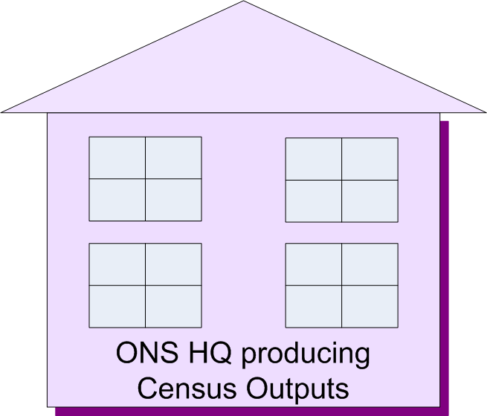
Notes:
Speaking from an ONS context. Responsibility for provision of Census outputs for England and Wales. NRS and NISRA for Scotland and NI respectively.
So.. Within ONS, taking all that data provided on Census forms, and producing statistical outputs.
Those outputs are required by, and will be used by a wide range of different types of uses for a wide range of needs and purposes.
Our goal/objective, is to get the most benefit or value derived from those statistics. That is doe by you the users, not ourselves.. So we need to make sure we provide the data in ways that enables the

Slide 4
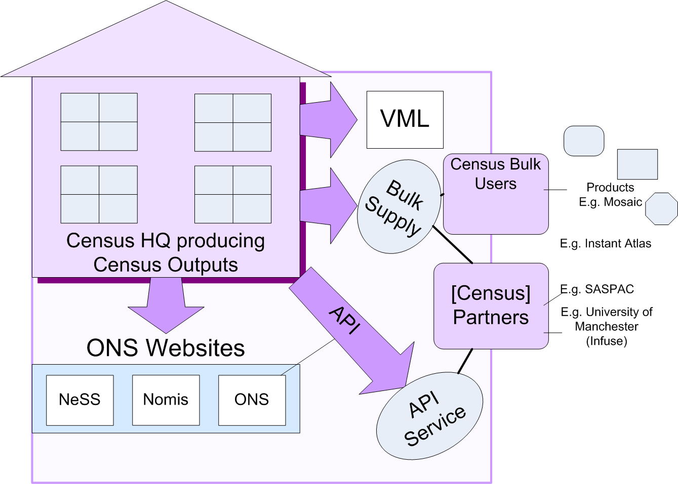
Dissemination channels Options for different users &uses

Slide 5
Explaining the channels
ONS Websites
API and API Service
Bulk Supply
Virtual Microdata Lab
Census Partners / Intermediaries / Products

Slide 6
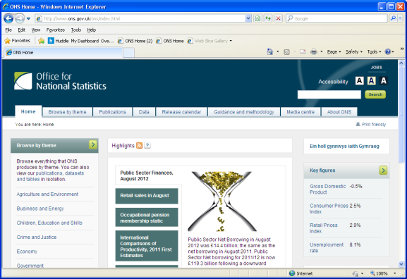
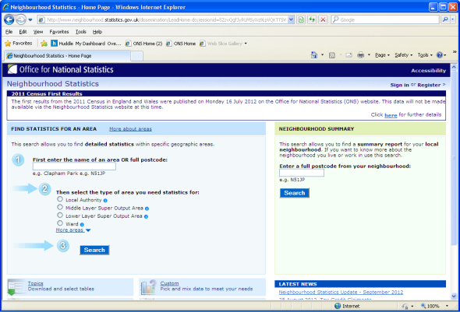
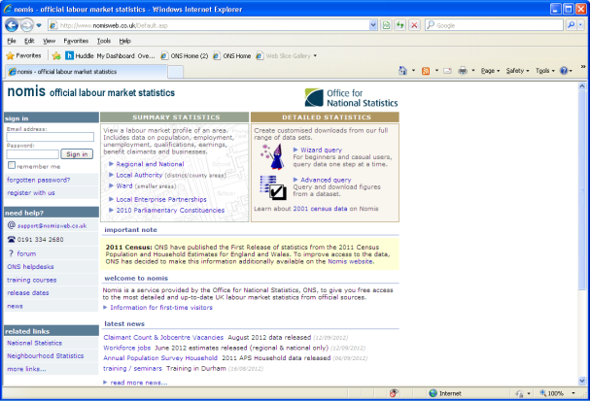
ONS Websites
Main ONS website
www.ons.gov.uk
www.ons.gov.uk/census
Neighbourhood Statistics
www.neighbourhood.statistics.gov.uk
Nomis
www.nomisweb.co.uk

Slide 7
All will have broadly similar functionality enabling the user to:
Find/discover datasets
Slice by topic and geography
View on-line
Download
Supporting Information (metadata)
Basic data visualisation
This functionality is still in development for the main ONS website
The main ONS website will also host the Census Analysis, Data Visualisations created by ONS, and Statistical Bulletins etc.

Slide 8
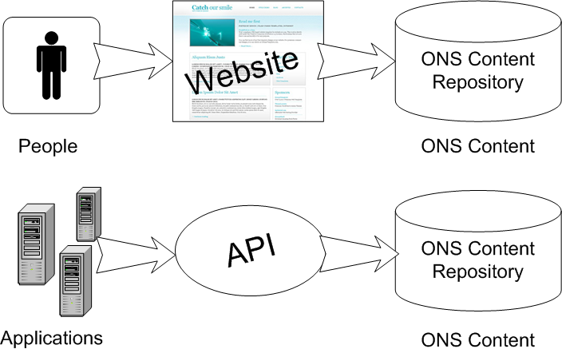
API (Application Programming Interface)
Developed for other systems that want to programmatically take and re-use ONS data - often replacing the need to download, reformat and upload data
Enables others systems to more easily include ONS data in their products/systems, and the utilisation of existing web tools to visualise ONS data (from large systems to simple mash-ups)
A person interacts with our content through a website. The API enables the same sorts of interactions for another application

Slide 9
API Service
The API Service allows access to the API, and supports and encourages use of the API and collaboration between users
Registration
How do I? / Tutorials
Example Code
Blog, Forum, Gallery
“Enablement Tools”

Slide 10
API Demonstrations

Slide 11
Bulk Supply
All tables for a given release on a ‘hard media’ (e.g. CD/DVD or portable hard drive)
On request to Census Customer Services
CSV format (working group agreed) and XML (SDMX)
Planning to provide cell numbered table layouts prior to release of data

Slide 12
Virtual Microdata Lab
Will provide access to a range of SARS (Sample of Anonymised Records) products building on those produced in 2001
This provides access to a sample of unit level data which has been made anonymous

Slide 13
Census Partners / Intermediaries / Products
Other non-ONS systems that also provide users with access to Census data (and often other data as well)
Range of types
Often are more focused and best suited for providing Census data to specific audience types
Encouraged by ONS (complementary not competitive)
As well as alternative access, other organisations produce value added outputs

Slide 14
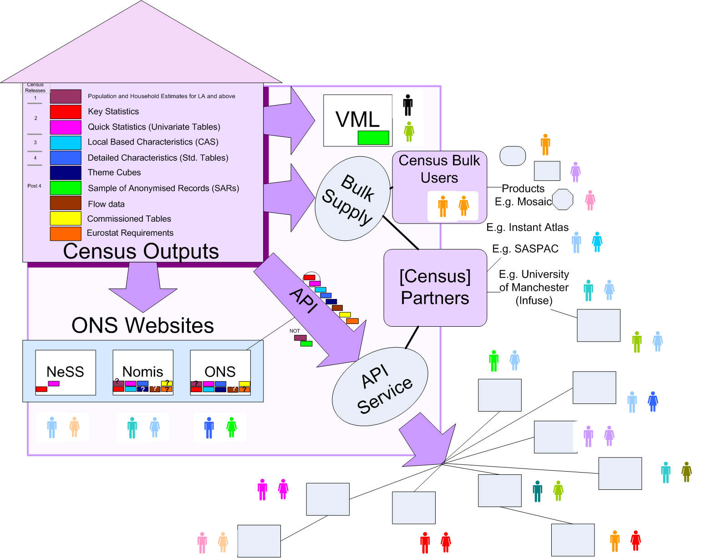

Slide 15
“What outputs are available on which system when?”

Slide 17
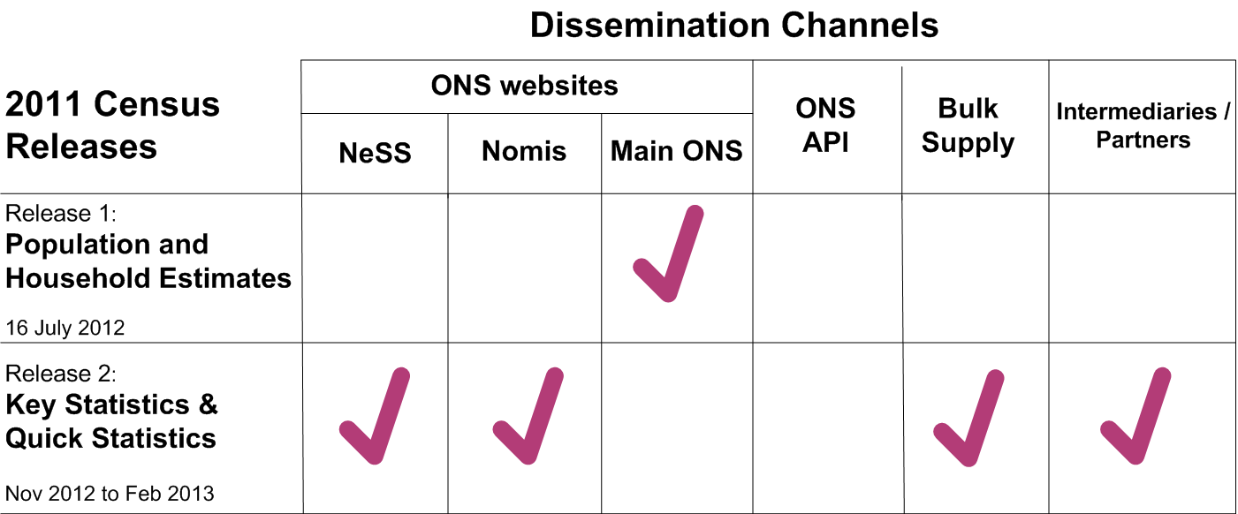

Slide 18
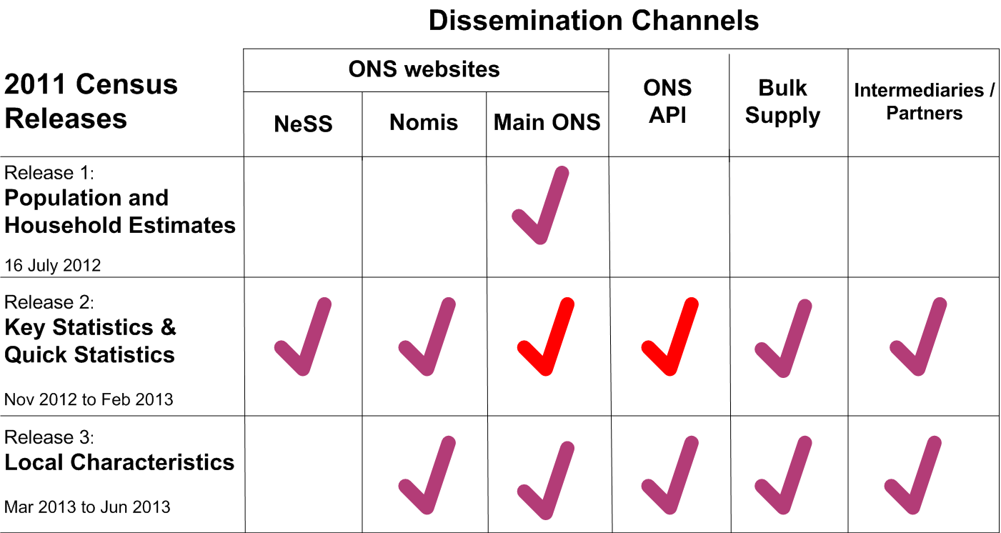

Slide 19
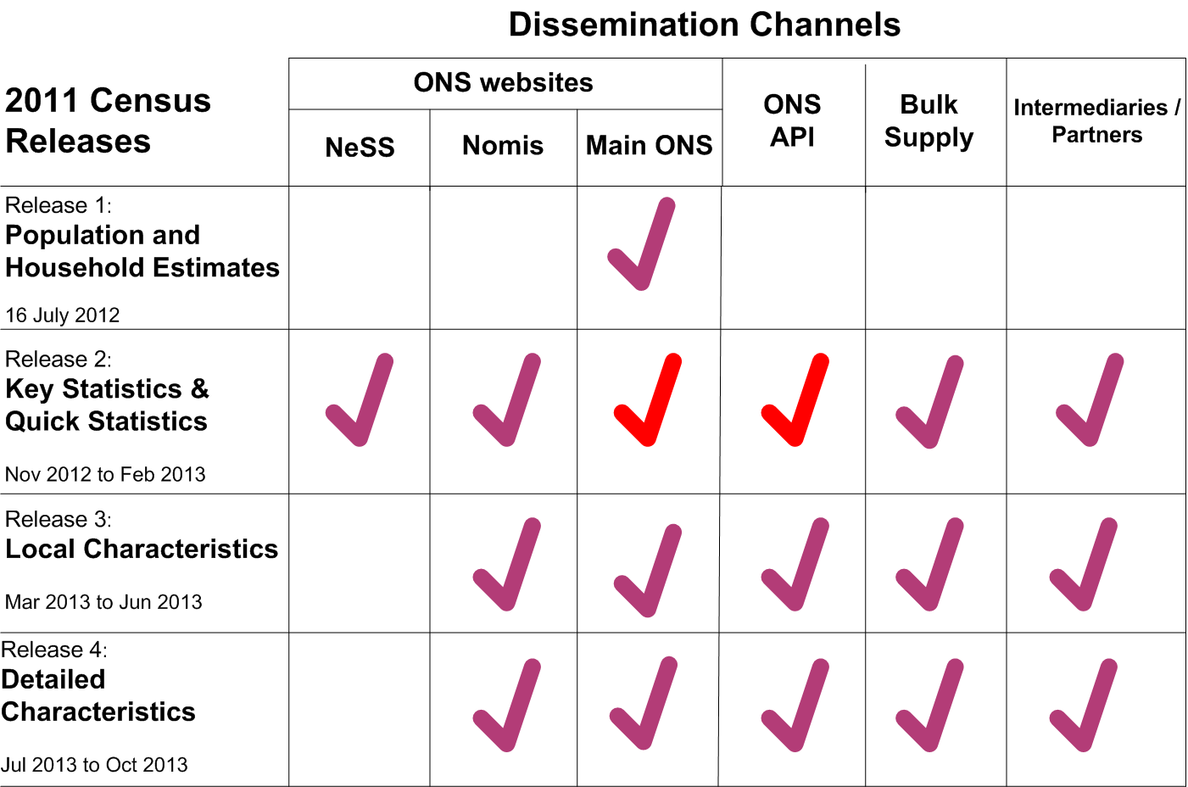

Slide 20
Focus on Release 2 Key and Quick Statistics
ONS Website
Headlines, Bulletins, Analysis, Data Visualisations, and signposting through to detailed data held on:
Neighbourhood Statistics Main journeys:
Neighbourhood Summary
Data for a single area
Download complete datasets
Customise (data for user specified, multiple areas and topics)
Boundary viewer
and Nomis
Similar journeys to NeSS
Note: both NeSS and Nomis do have own APIs

Slide 21
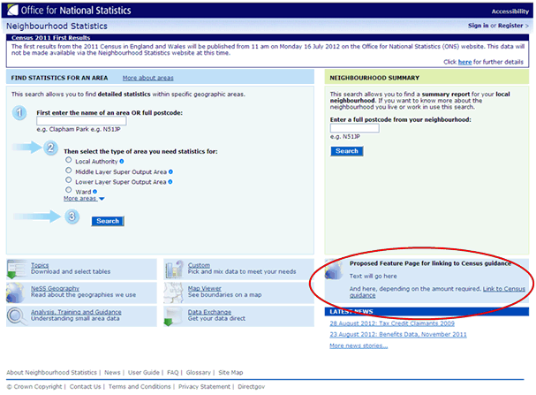
Download complete datasets

Slide 22
Customise datasets by Topic and Geography to get just slice you need

Slide 23
Get data for a single area (with comparison areas)

Slide 24
Find out more about, and explore geographies

Slide 25
Neighbourhood Summary showing range of data – with 2011 Census data tab

Slide 26
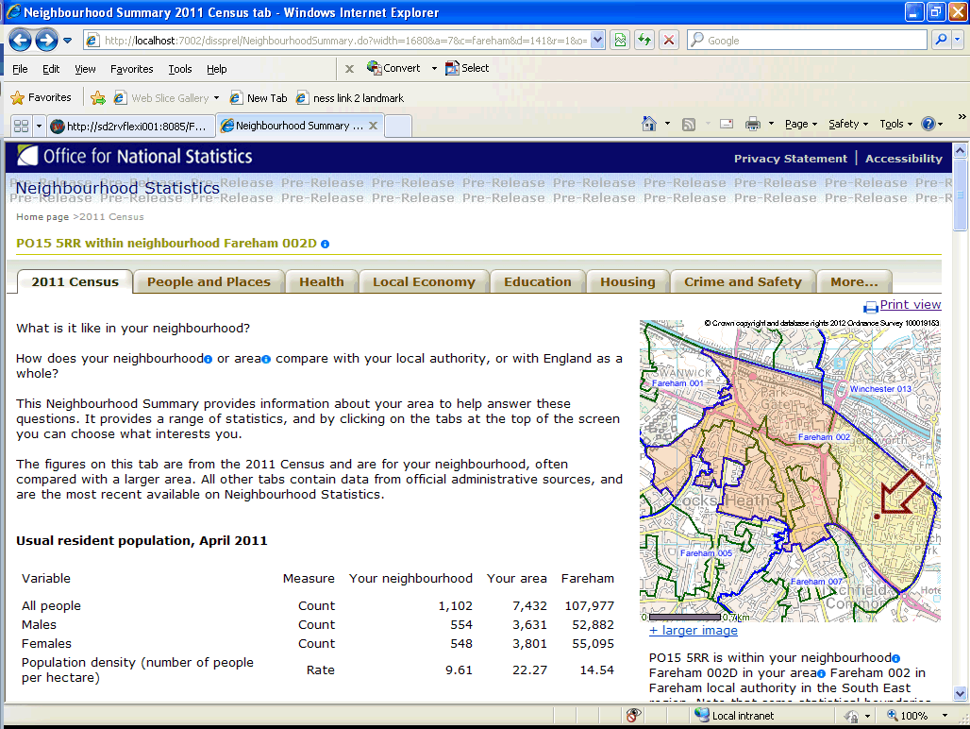

Slide 27
Keeping in touch
ONS Newsletter
To keep you informed about progress to deliver the 2011 Census outputs and the communication activities to support these. Published every two months to Local Authority members’, Assistant Census Liaison Managers, ex-census Regional Champions, Members of the Census Advisory Groups and people who register an interest. Contact: smc.team@ons.gsi.gov.uk Tel: (+44) 1329 447912
2011 Census Prospectus Sets out the release plans for the 2011 Census statistics and describes the statistics that the Office for National Statistics (ONS) will be releasing, and when ONS intends to publish them. Find out more at 2011 Census ONS Prospectus and sign up for prospectus email alerts
ONS Website User testing ONS have been asking users to test the new online tools before they go live. If you are interested in getting involved in testing the changes to the website then please contact: Stephen.d.kay@ons.gsi.gov.uk
Application Programming Interface (API) Service - education sessions ONS are developing an API tool to extend the reach of ONS data. We will be holding some API education sessions aimed at both technical and non technical users in the New Year. If you are interested in attending these then please contact: ONSAPI@ons.gsi.gov.uk
Online Communities and Members Working Groups Updates are also available via our on-line communities at www.Stats User Net.org.uk and for information on ONS API Working Groups please contact ONSAPI@ons.gsi.gov.uk

