Slide 1
2011 Census Outputs
“Making best use of 2011 Census”
Dr Emma White
Head of Policy and Analysis
2011 Census Outputs
Office for National Statistics
5 October 2012

Slide 2
Overview
2011 Census
Code of Practice
First results
Second release
Third release
Fourth release
Subsequent releases
How to get the numbers
Benefits realisation

Slide 3
2011 Census
27 March 2011
England and Wales
  People, households, communal establishments
  Characteristics
Why are census data important?
  Unique
  Detailed information across England and Wales at low level of geography
  Change over time
  Value for money
  Targeted record swapping

Slide 4

Code of Practice
National Statistics Code of Practice
  The range of official statistics should meet the needs of users
  Statistics should be produced, managed and disseminated to high standards
  Statistics should be well explained
  Communication of statistical ideas
What does this mean for ONS and 2011 Census?

Slide 5
First release: population & household estimates
16 July 2012
Single year of age by sex, England and Wales
Five year age by sex, LADs/UAs England and Wales
Household estimates
LA quality assurance information
Population 56.1m on 27 March 2011
  England 53.0m
  Wales 3.1m
  Females 28.5m (51 per cent)
  Males 27.6m (49 per cent)

Slide 6
First release contd
Growth
  Population grew by 3.7m (7.1 per cent) since 2001
  London region saw biggest growth, exceeds 8m
  Largest number over 65s since 1801
  Increased numbers in 20s
  Increased number young children
Three reasons for population change
  6.6m births, 5.0m deaths in period 2001 to 2011
    45 per cent of the increase
  2.1m is migration: international and internal
    55 per cent of the increase
  Some births are an indirect effect of migration

Slide 7
First release contd
24 September 2012
2011 Census - Population and Household Estimates for England and Wales - Unrounded Figures for the Data Published 16 July 2012
2011 Census - Population and Household Estimates for Wales - Unrounded Figures for the Data Published 16 July 2012

Slide 8
Population growth since 1801
England and Wales 1801 to 2011
Comparison with 2001 and 1991 is based on mid-year population estimates for those years, comparison with 1981 and earlier is based on census results. No census in 1941 due to the Second World War

Slide 9
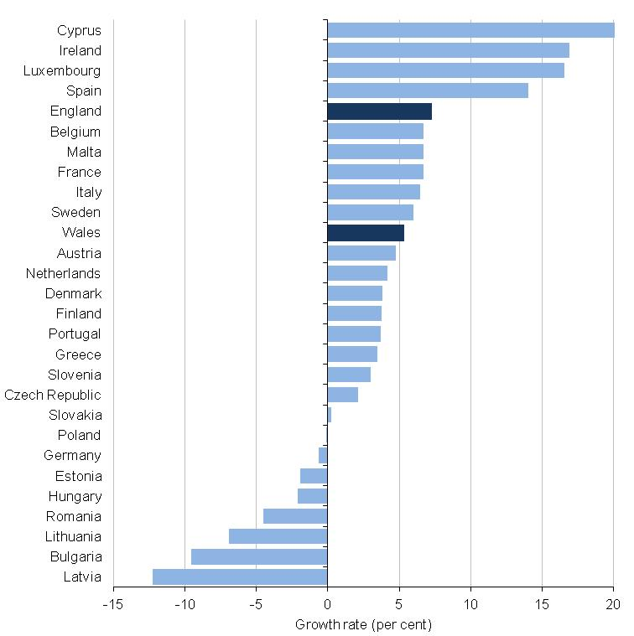
Population growth rate of EU27 countries
2001 to 2011

Slide 10
Age structure
2011
Population pyramid
England and Wales

Slide 11
Age structure 1951 to 2011: more people & increased life expectancy

Slide 12
Age structure 1951 to 2011: WWI & Spanish influenza

Slide 13
Age structure 1951 to 2011: post
WWII baby boom

Slide 14
Age structure 1951 to 2011: echo
effect

Slide 15
Changing age structure
2011 vs 2001

Slide 16
Age structure compared
2011 vs 2001
2011 age structure
2001 overlaid (dotted line)

Slide 17
Age structure compared
2011 vs 2001 contd
2011 age structure 2001 overlaid
Aged on 10 years

Slide 18
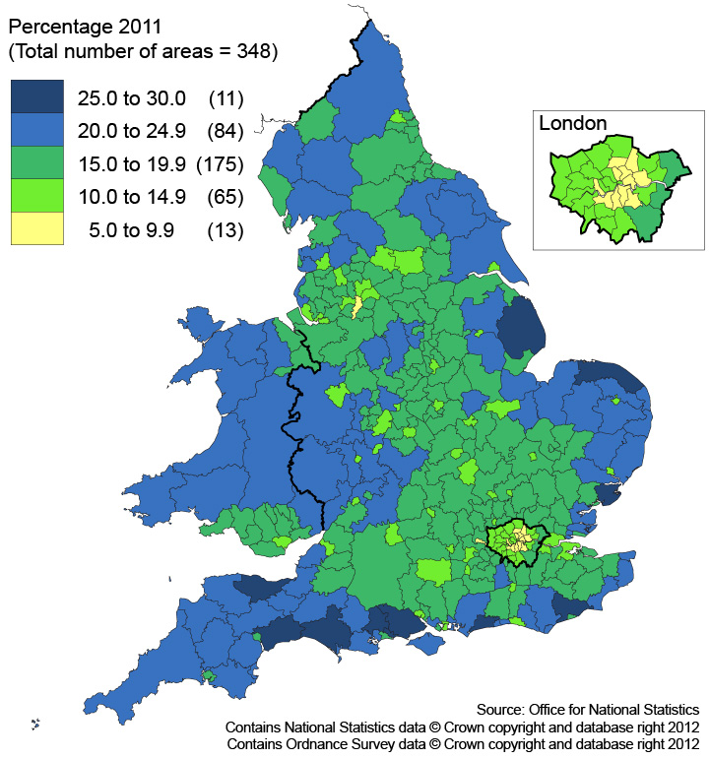
Usual residents aged 65 and over by local authority
2011

Slide 19
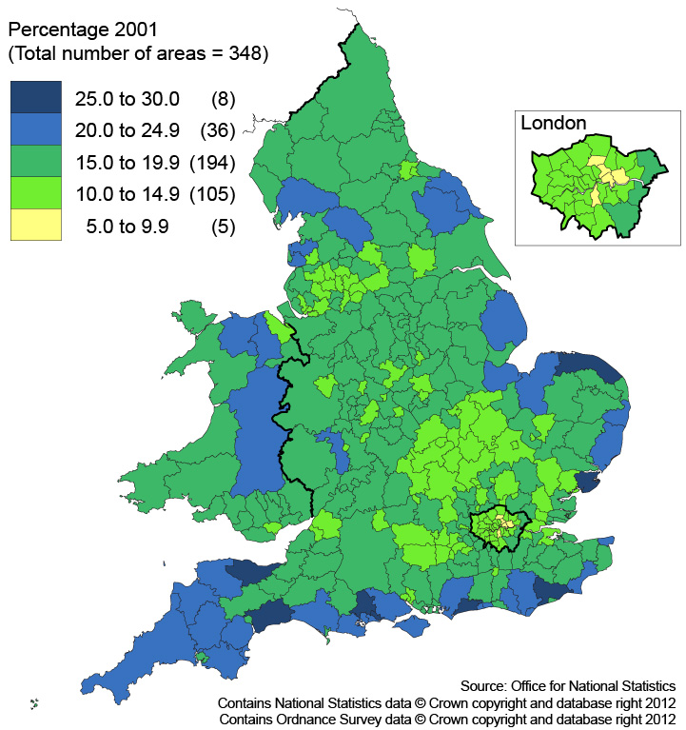
Usual residents aged 65 and over by local authority
2001

Slide 20
Regional growth since 2001

Slide 21
Local authority population growth since 2001
London
Rest of England & Wales
Local authority | Percentage change % |  | Local authority | Percentage change %
Tower Hamlets | 26 |  | Manchester | 19
Newham | 23 |  | Milton Keynes | 17
Hackney | 19 |  | Leicester | 17
Hounslow | 18 |  | Peterborough | 17
Greenwich | 17 |  | Slough | 16
Waltham Forest | 16 |  | Swindon | 16
Brent | 15 |  | South Derbyshire | 16
Redbridge | 15 |  | Boston | 16
Haringey | 15 |  | South Holland | 15
Islington | 15 |  | Uttlesford | 15

Slide 22
Average household size

Slide 23
Second release: quick & key statistics
November 2012 to February 2013
Univariate outputs on existing and new topics
Postcode estimates
Phased by geography
  OA hierarchy, wards
  Parliamentary constituencies, parishes
  Other

Slide 24

Second release contd
Unprecedented detail at output area geography
40 households, 100 people
Comparability
Statistical bulletin
Short stories
Data visualisation

Slide 25
Third & fourth releases: local & detailed characteristics
Third release
Local characteristics (equivalent to 2001 CAS)
  March to June 2013
    Contents, comparability, data visualisation
    Less detail, lower geography
Fourth release
Detailed characteristics (equivalent to 2001 Standard)
  July to October 2013
    Contents, comparability, data visualisation
    More detail, higher geography

Slide 26
Subsequent releases: specialist products
Micro data
  1. Secure
  Individual Controlled Access Microdata Sample (CAMS)
  Household CAMS
  2. Safeguarded
  Individual Samples of Anonymised Records (SAR)
  Household SAR
  3. Public Use
  Individual SAR
  Individual Test Dataset
Flow data
Small populations

Slide 27
Subsequent releases: specialist products contd
Alternative population bases
  Short term residents
  Workplace
  Workday
  Out of term
  Majority of time
Commissioned tables

Slide 28
How to get census results
  Population and household estimates July 2012
    ONS website
  Key and quick statistics from November 2012
    Neighbourhood statistics website, NeSS
      Over ten times as many concurrent users as before
      Signposted from the ONS landing page
    NOMIS website
      www.nomisweb.co.uk
    Bulk supply for those who want the complete set of data
  Local and detailed characteristics from March 2013
    ONS website
  As data explorer and API come online, census data will make increasing use of added functionality

Slide 29



Realising the benefits
The census is a rich and unique data set
Census data are used to allocate funds
Local authorities use local data on populations so local plans better reflect future local needs and development happens in the right places
Census underpins consumer market research for the design of surveys
Census data help retail businesses tailor their stores so that they better match the interests of local people
Census data can shed light on policy or social issues – family types, carers, areas of deprivation, environmental pressures etc
…and we aim to ensure that the opportunities
that the census release presents are maximised

Slide 30
Maximising the benefits
Identify policy areas that census data can support
Engage government departments to exploit census results
  Ensure easy access to data – accessible tools and systems
  Fully utilise all the census data – eg new questions, cross-classifications
  Identify new users – make outputs interesting and meaningful to ‘me’, media stories, case studies
  Add value by ensuring that the statistics are enhanced eg analysis, data visualisation
  Deliver innovation where appropriate
  Encourage use through initiatives, competitions, media
  Develop partnerships with external users who can add
  value and reach

Slide 31

And finally…
Benefit realisation quantification
In liaison with users, catalogue the uses of the results, prepare case studies and, where possible, aim to place an economic value on the range of uses of data

Slide 32
Summary
2011 Census
National Statistics Code of Practice
First results
Second release
Third release
Fourth release
Subsequent releases
How to get the census numbers
Benefits realisation

Slide 33
Prospectus and contact details
Online dynamic prospectus 26 March 2012
  Describes plans and products
  Timetable updated on an ongoing basis
  Table layouts and classifications
  Glossary
Sign up for email alerts via census pages
www.ons.gov.uk
Contact
census.customerservices@ons.gsi.gov.uk

Slide 34
Questions
?

