Slide 1
Simple Census Aggregate Data Without the Tables
Justin Hayes
Census Support Service
UK Data Service
TWRI Conference
5 October 2012

Slide 2
Census Tables
Visualisation on a 2D printed page
Separate datasets with inconsistencies
Different categories and labels
Limited cross-search
Limited descriptive metadata
Supporting documentation
Table-centric constraints on data produced

Slide 3
Pulling the census apart
2001 Census
Table deconstruction
Concepts, variables and categories
Universes and footnotes
Additional metadata
Definitions Volume
Question text
Processing methodologies

Slide 4
Putting it back together again
Condense variables
Rationalise labels
Unified semantic data model
Encode hierarchies (including geography)
Incorporate metadata
Multiple observation values

Slide 5
Building InFuse
Initial implementation of data structure
Simple semantic cross-search
Operation on data and metadata
Guided search
No data fast!

Slide 6
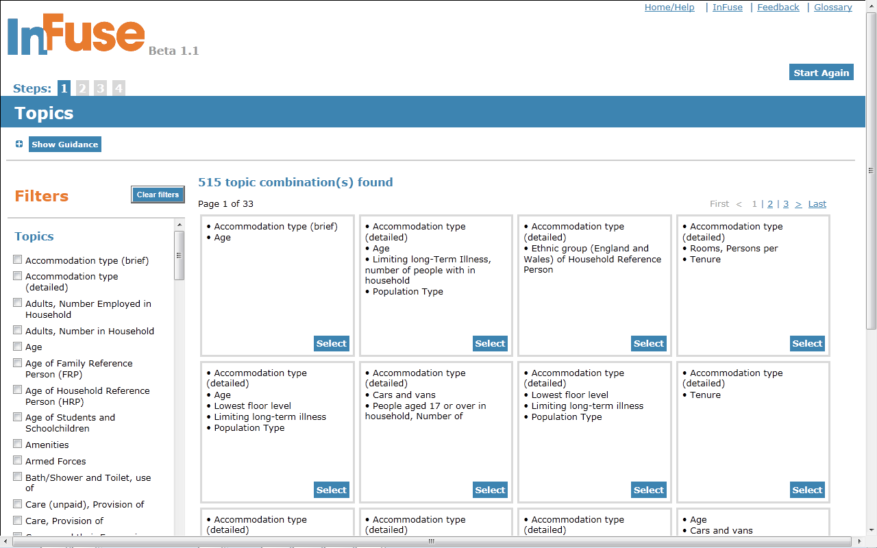

Slide 7
A researcher wants to compare modes of travel to work amongst young men and women resident in different wards in Greater Manchester

Slide 9
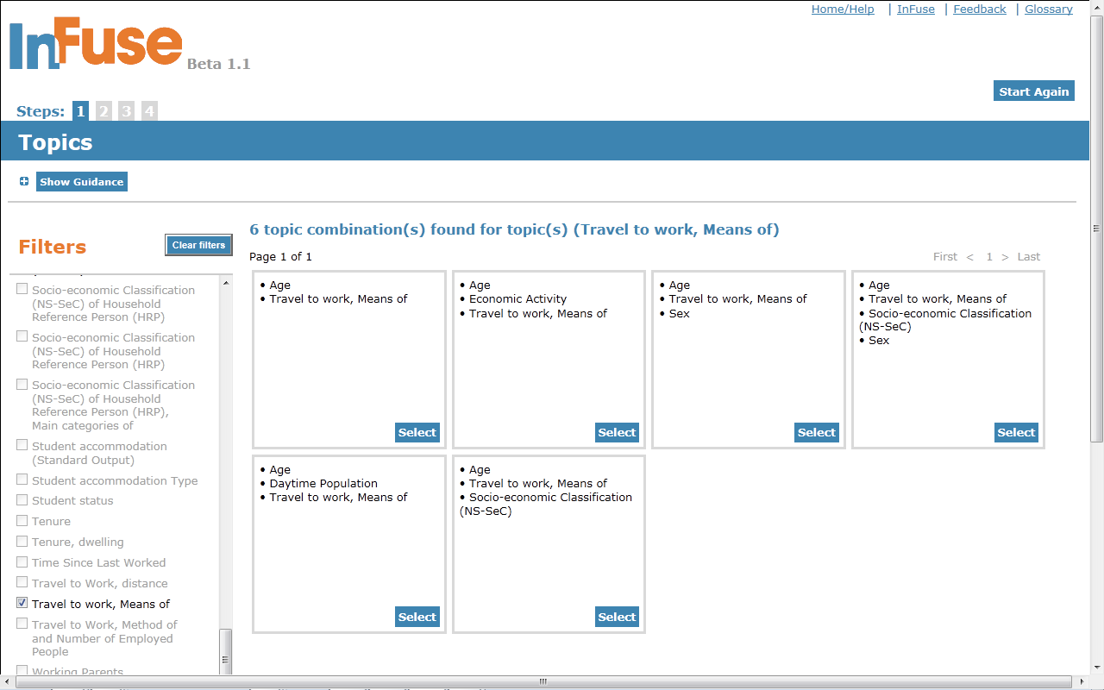

Slide 10
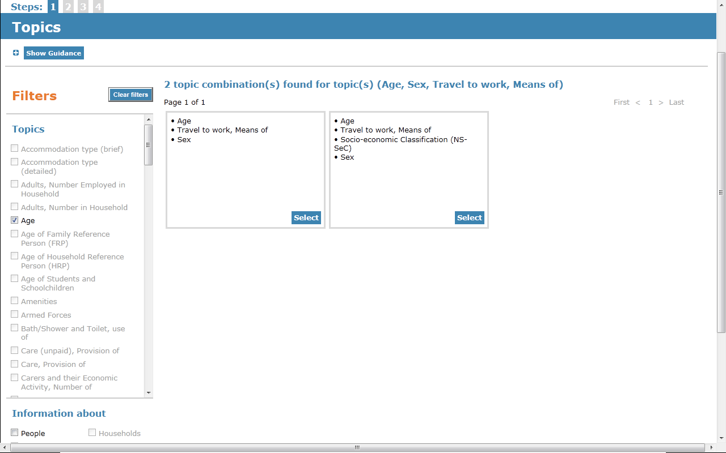

Slide 11
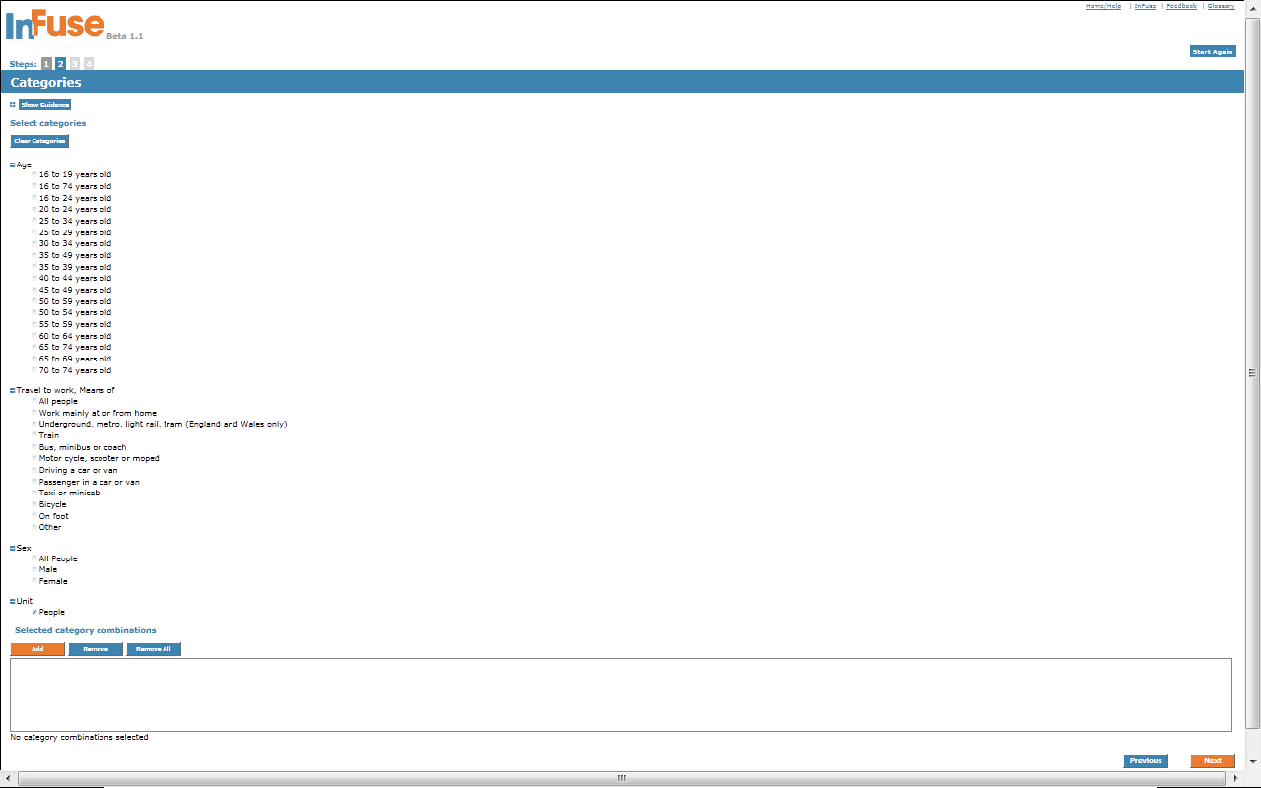

Slide 12
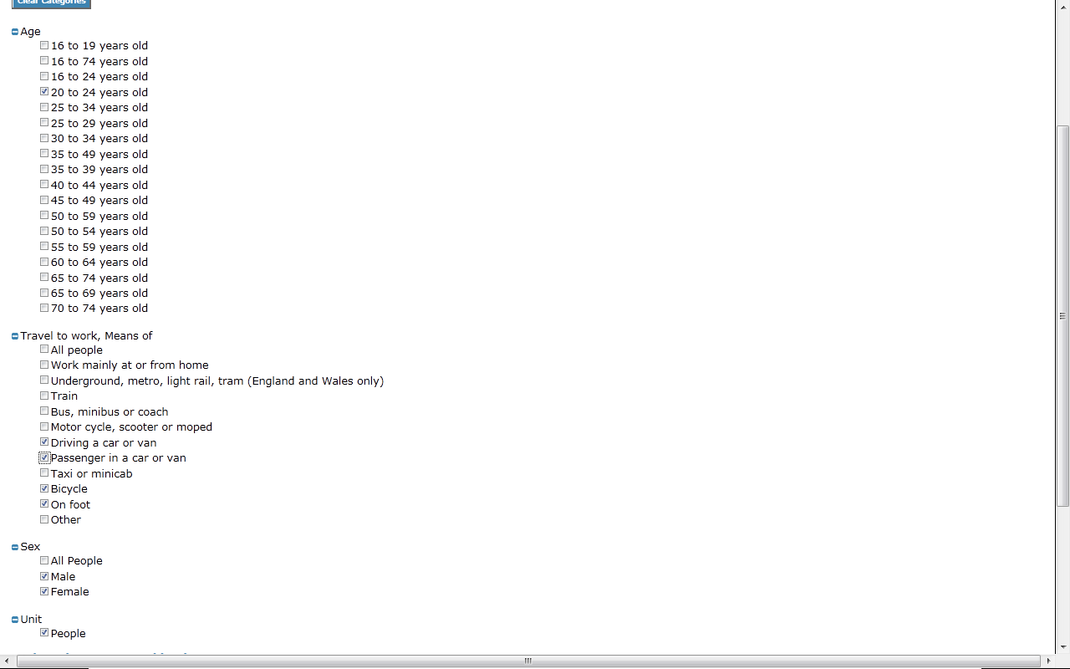

Slide 14
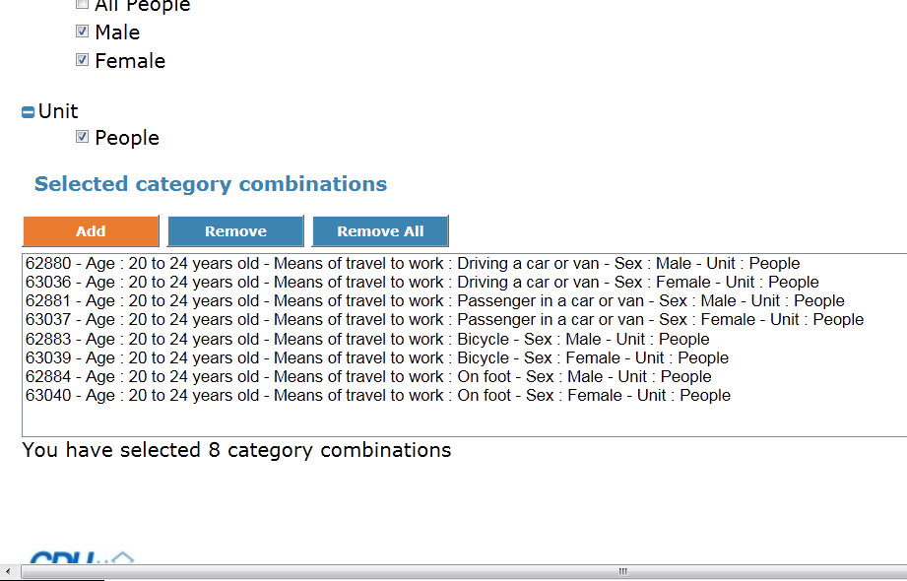

Slide 15
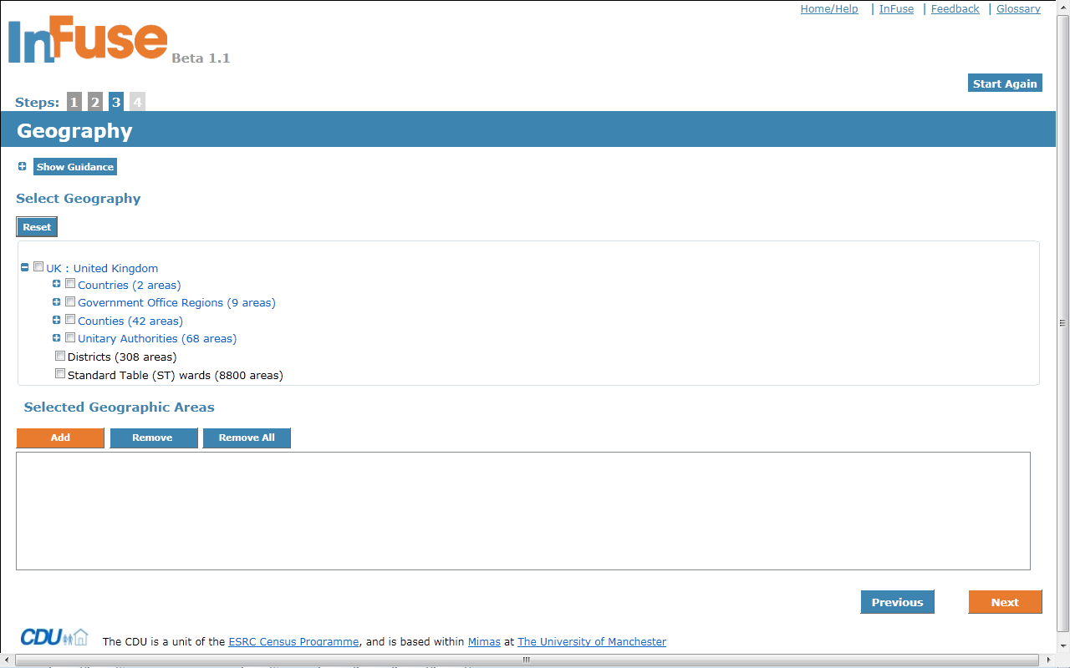

Slide 16
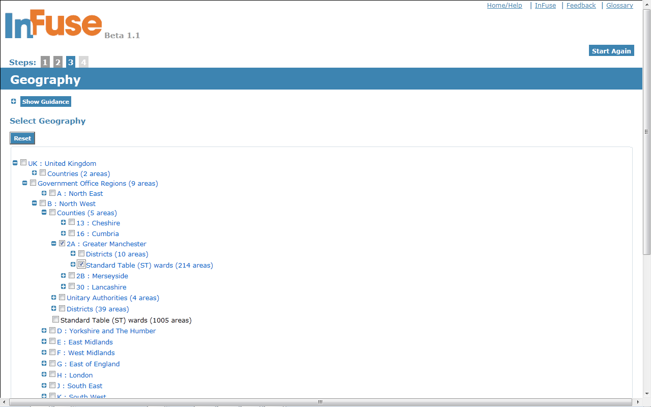

Slide 18
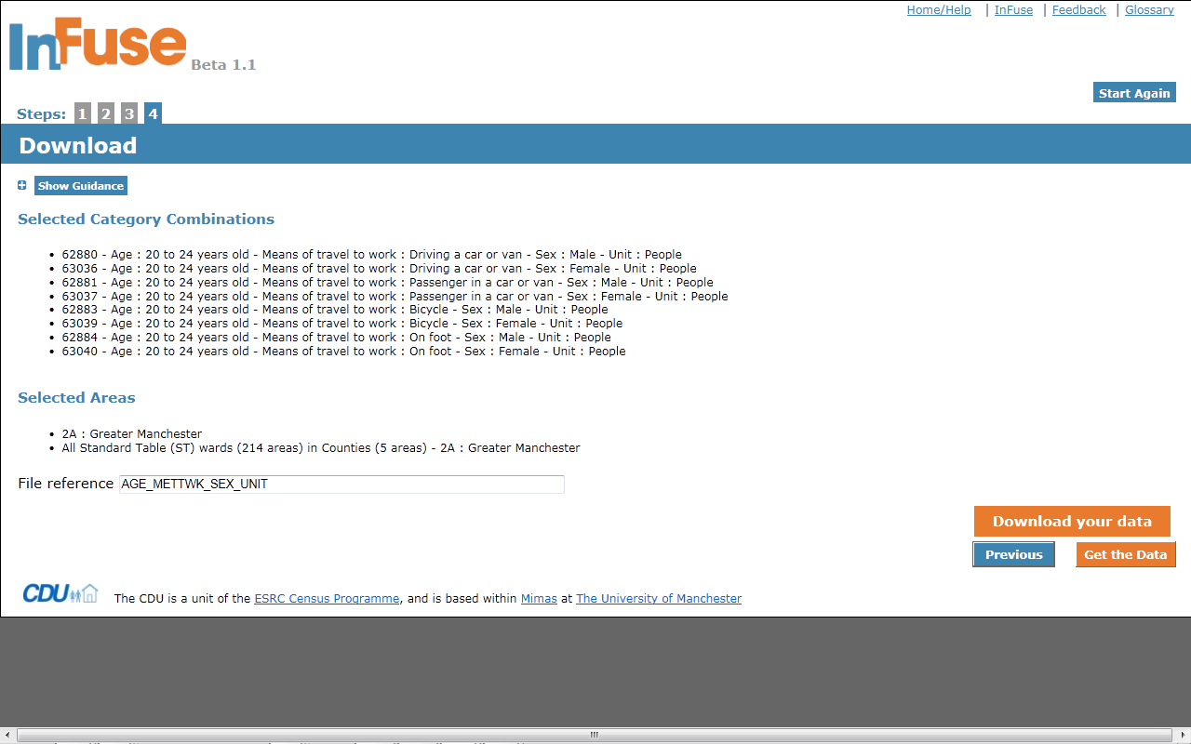

Slide 19
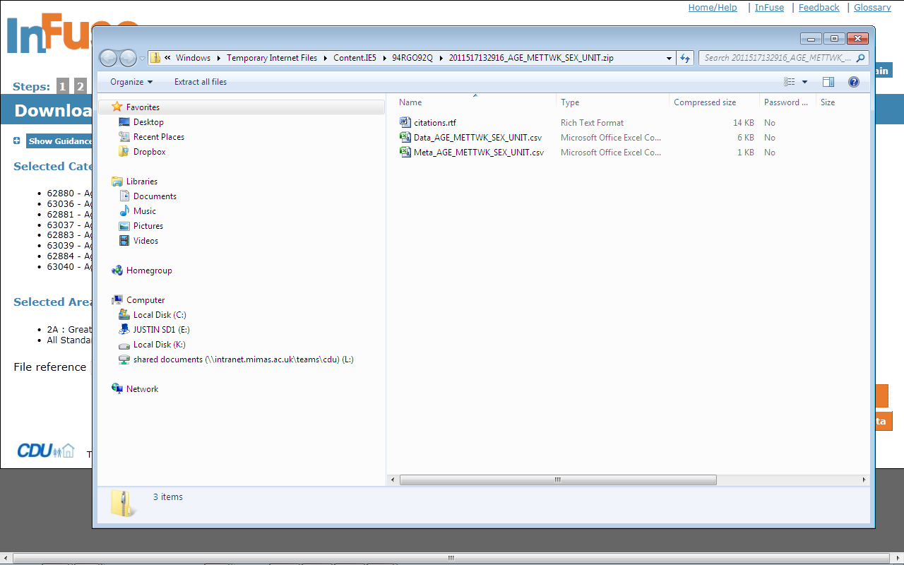

Slide 20
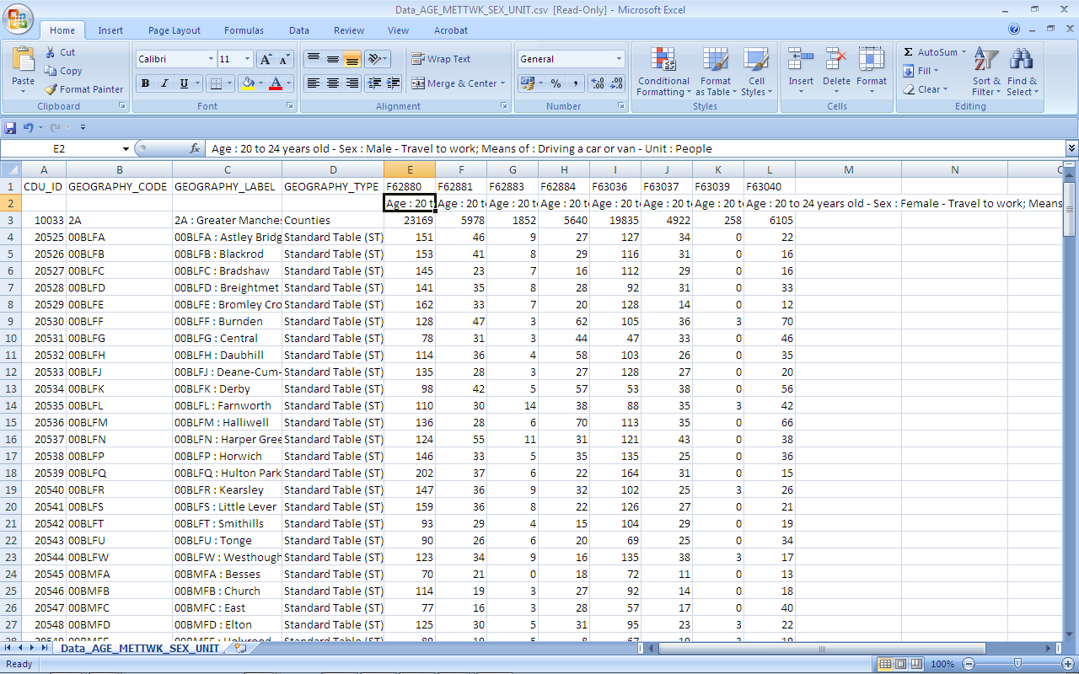

Slide 21
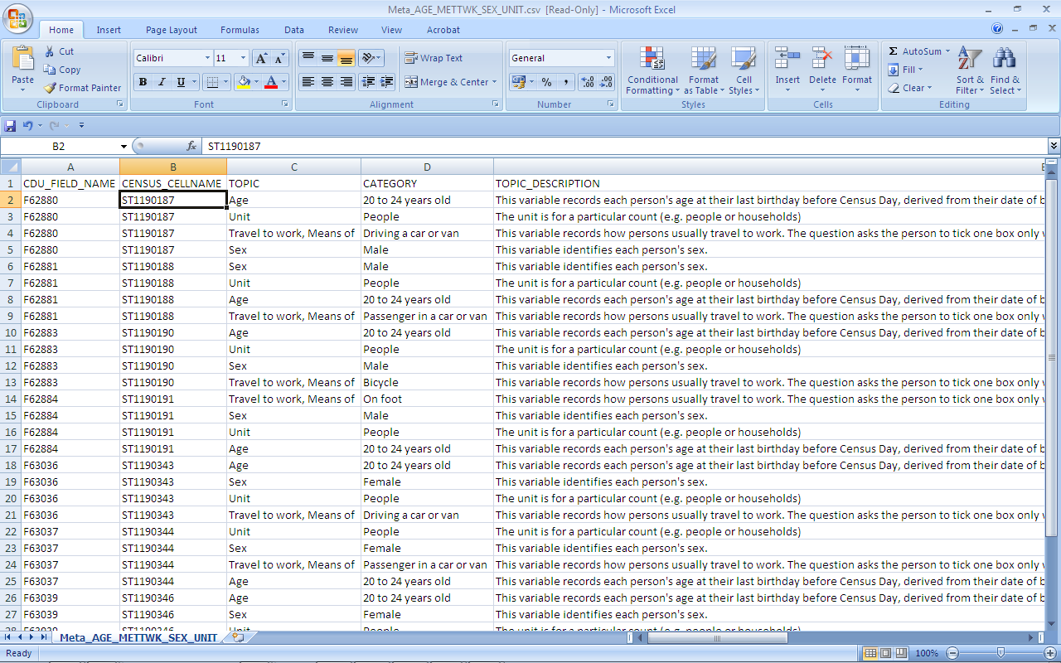

Slide 22
Feedback
I will ENTHUSE about INFUSE! Congratulations! I used it intuitively without a hitch to get a table I wanted. Looking forward to doing the same with 2011 data next year. Researchers and students will like it a lot, though teachers will now have to re-write their course materials. Phil Rees, University of Leeds
InFuse makes a lot of sense to us. Navigating by variables is extremely useful. I also agree with the point you made about it being as useful for what you can find as what you can’t. I have wasted hours of my life searching through all sorts of tables on NOMIS, ONS, etc looking for things that don’t exist! Ian Geer, Office of the Chief Executive, Liverpool City Council
It’s vital to help users of the Census to express their needs in simple terms (“I want to see the population classified by Age, Ethnicity, & Education.....”) and so swiftly find what they want, without specialist knowledge: the Infuse project has already made great progress towards removing barriers to access. Keith Dugmore, Demographic Decisions Ltd

Slide 23
Into the Future
Public InFuse?
2011 rapidly following releases
2011 – 2001 comparability
GIS boundary data
Use of Open Apps
1991, 1981, 1971 …
More non-census data via APIs
Table-free datasets

